Slide 1
Advanced VLSI Chip Design Project: Design and implement ASIC for Neural Network inference engine
P V Rajesh Kumar

Slide 2
Introduction
Problem Statement
Design and implement an ASIC for a Neural Network inference engine.
Dataset description
Semeion Handwritten Digit Dataset semeion.data (UCI ML Repository)
Reference: https://archive.ics.uci.edu/ml/datasets/semeion+handwritten+digit
Dataset Details:
Dataset is a 1593 x 256 Matrix
1593 images contains Train Data: 1100, Test Data: 493
Each image is 16x16 binary vectorized to 256 bits
10 Classification outputs one hot encoded (1 out of 10 is 1, rest are 0) at last 10 bits.

Slide 3
Network Description
Network architecture
Fully connected Neural Network with feed forward.
Feed-forward step, where input is fed to the model acting upon the model parameters and operators.
It generates an output of each layer of the model i.e., activations, finally generating the model output.
Model parameters supplied are pre-trained using Matlab.
This model does inference part only.
Network parameters –
Number of Inputs: 256 bit data representing 16x16 pixels of image
Number of outputs: 10
Number of neurons in hidden layer: 40
Activation function for hidden layer: Leaky RELU
Output format: One-Hot encoded with 10 bits. LSB to MSB each bit represents the digit recognized from 0 to 9.

Slide 4
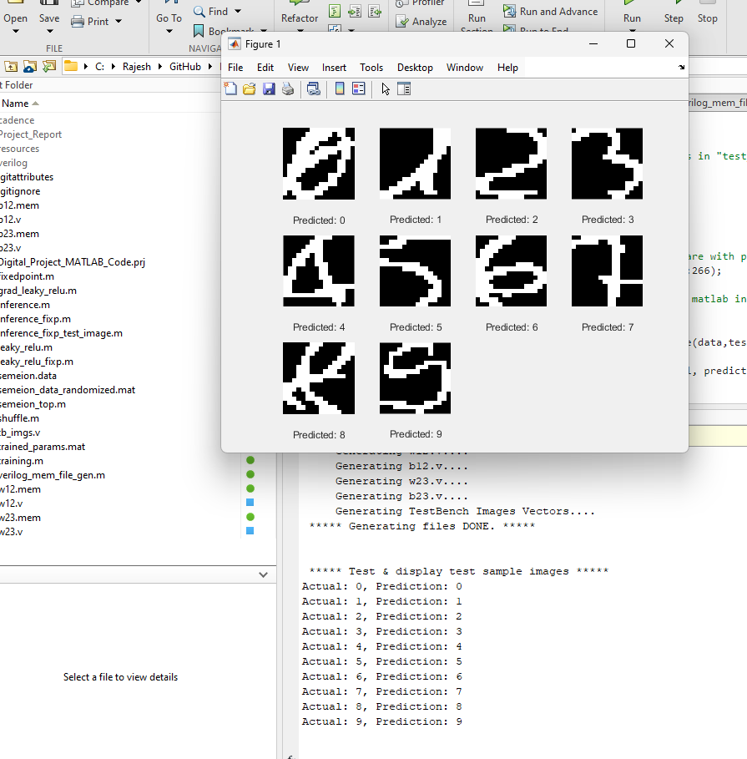
Software Implementation
Tasks performed on MATLAB.
Chnaged training parameters for Training accuracy: 99.3636%, Test accuracy: 90.8722%
Created Modal Parameters from Training for above accuracy
Implemented Fixedpoint representation
Implemented Inference part for Testing Input data using FixedPoint representation
Generation of Verilog files for Modal Parameters

Slide 5
Software Implementation (contd..)
Highlight any optimizations you performed on given code.
Implemented Fixedpoint conversion
Made the code configurable for training, FixedPoint bits, Training, RELU Slope, Hidden Nodes, Generate Verilog files dump, Run with FixedPoint or Floating, RELU for FixedPoint.
Added GUI for test outputs

Slide 6
Software Implementation (contd..)
Fixed point design approach:
Bit widths allocated: 16bit. Integer: 8 Fraction:8.
Total memory needed for weights and biases:
wire signed [0:15] w12 [0:39][0:255]; //40x256x16 bits: 20480 Bytes
wire signed [0:15] b12 [0:39]; //40x16 bits: 80 Bytes
wire signed [0:15] w23 [0:9][0:39]; //10x40x16 bits: 800 Bytes
wire signed [0:15] b23 [0:9]; //10x16 bits: 20 Bytes
Total: 21380 Bytes ~ 20.76 KB
Size of multiplier needed
%Some points for Fixed point calculations
% Q point calculations go like this
% Q8 + Q8 = Q8, % Q32 + Q32 = Q32
% Q8 * Q8 = Q16, % Q32 * Q32 = Q64
% Fractional parts calculations with below examples
% Q16.8 * Q1.0 = Q17.8
% Q17.8 + Q16.8 = Q17.8
% Q11.8 * Q17.8 = Q28.16

Slide 7
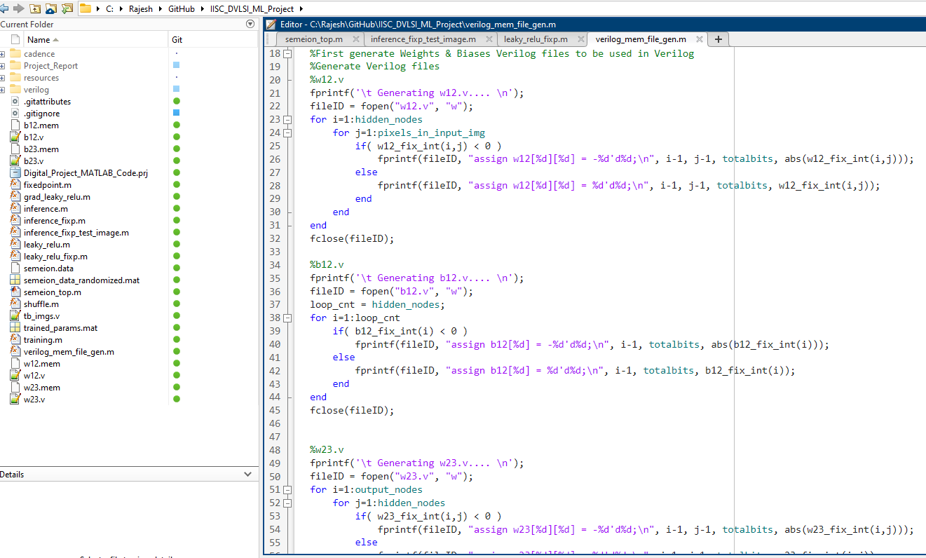
Software Implementation (contd..)
Scripting to get HW compatible data.
Added scripts to generate HW Verilog code snippets, for Modal Parameters
Weights: W12, W23, Biases: B12, B23
These files can be directly used in Verilog & are configurable though global configuration Variables in MATLAB

Slide 8
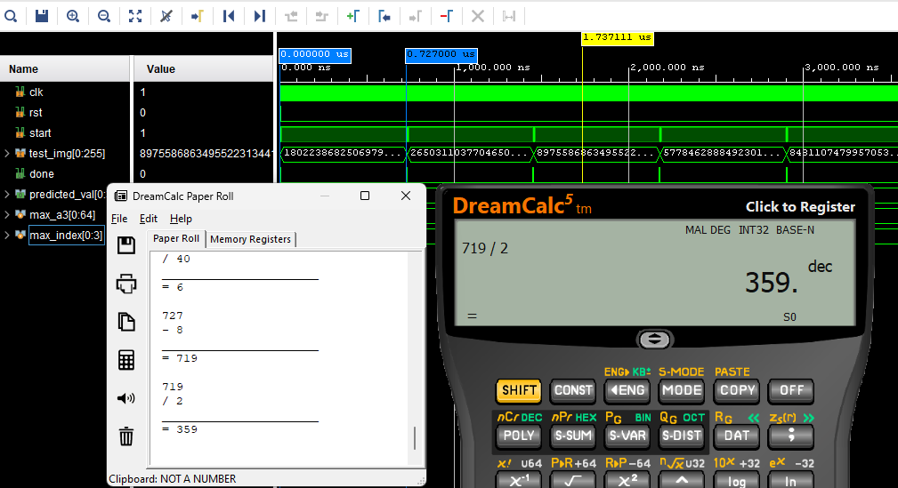
Hardware Specifications
Frequency of operation: 20 ns
Latency – For 1 input image, from START signal to DONE signal: 359 cycles
I/Os used in thedesign:
Input | Bit width | Notes
clk | 1 bit | Used for Clock
rst | 1 bit | Used for RESET (POSEDGE)
start | 1 bit | Used for giving as signal to start performing inference on the image
test_img | 256 bits | Input Image data in 256 bits
Output | Bit width | Notes
done | 1 bit | Outputs when the inference is done
predicted_val | 4 bits | Predicted value based on the input test_img

Slide 9
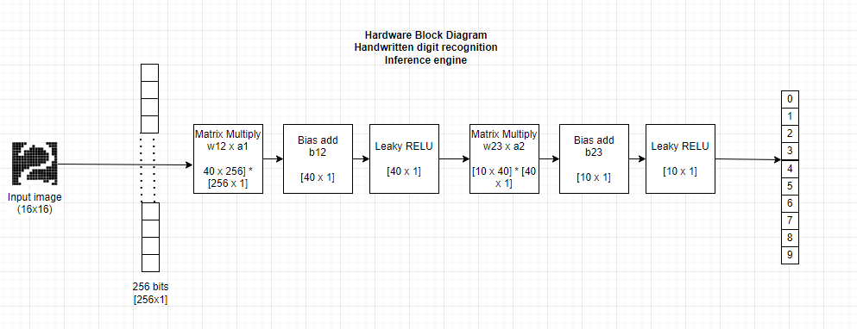
Hardware Architecture
Block diagram of Hardware implementation

Slide 10
Hardware Architecture
High-level design comprises of following steps:
Inputs
clk (positive edge-triggered CLOCK)
rst (positive edge-triggered RESET)
start (positive edge-triggered to START inference)
Test_img (256 bits test image 16x16 pixels)
Outputs
done (1 bit to signal inference is DONE)
predicted_val (The digit predicted in [0-3] bits range 0 to 9 corresponding to the digit value)
States of operation
Matrix multiply hidden layer weights (w12 x a1 i.e. Matrix Multiplication [40 x 256] * [256 x 1])
Bias add hidden weights (z2 = w12 x a1 +b12 i.e. Matrix addition 40 x 1)
Leaky RELU (On z2 = a2 i.e. 40 x 1). This is the Hidden layers output.
Matrix multiply output layer weights (w23 x a2 i.e. Matrix Multiplication [10 x 40] * [40 x 1])
Bias add final layer weights (z3 = w23 x a2 +b23 10 x 1 i.e. Matrix addition 10 x 1)
Leaky RELU (On z2 = a3 i.e. 10 x 1). This is the Output layers output.
Find Max of a3 to predict the image (The digit in [0-3] bits range 0 to 9 range.
done bit (signals end of inference is complete)

Slide 11
Control FSM
FSM
// States of the operations
parameter IDLE = 4'b0000; //IDLE upon RESET & initializes all Regs used in operation & waits for START signal to go to W12 multiply
parameter W12_MULTIPLY = 4'b0001; // Weights W12 Multiply on input Image
parameter B12_ADDITION = 4'b0010; //Add Biases of B12
parameter RELU_STAGE1 = 4'b0011; //Apply LEAKY RELU on the Added Biases
parameter W23_MULTIPLY = 4'b0100; // Weights W23 Multiply on output of LEAKY RELU output
parameter B23_ADDITION = 4'b0101; //Add Biases of B23
parameter RELU_STAGE2 = 4'b0110; //Apply LEAKY RELU on the Added Biases
parameter PREDICTION = 4'b0111; //Predict the value
parameter FINISHED = 4'b1000; //Generate a DONE signal as output

Slide 12
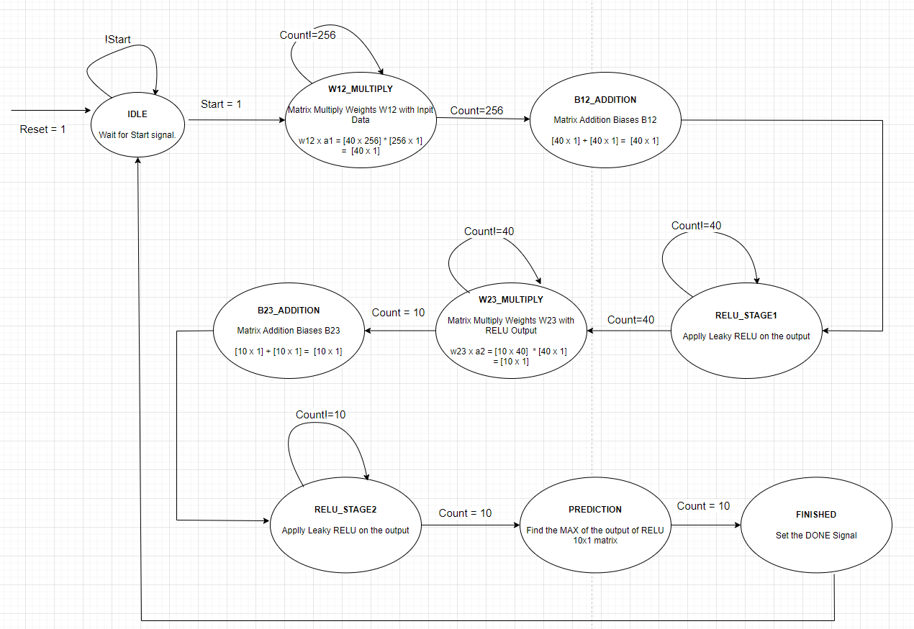
Control FSM (contd..)

Slide 13
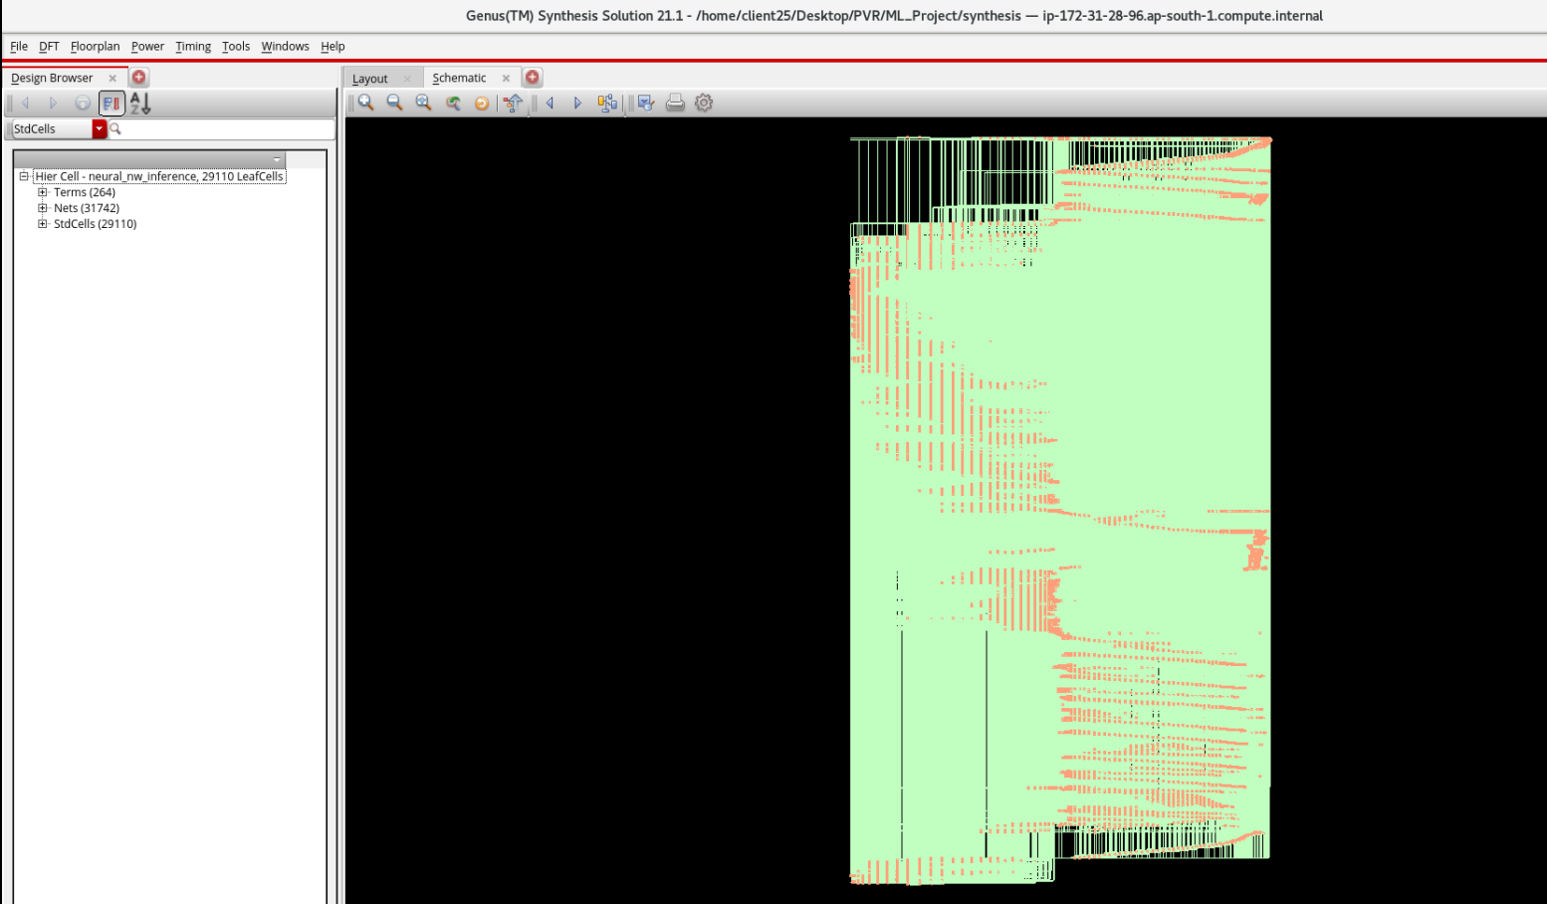
Hardware Schematic
Picture of Schematic from Genus (post-synthesis)

Slide 14
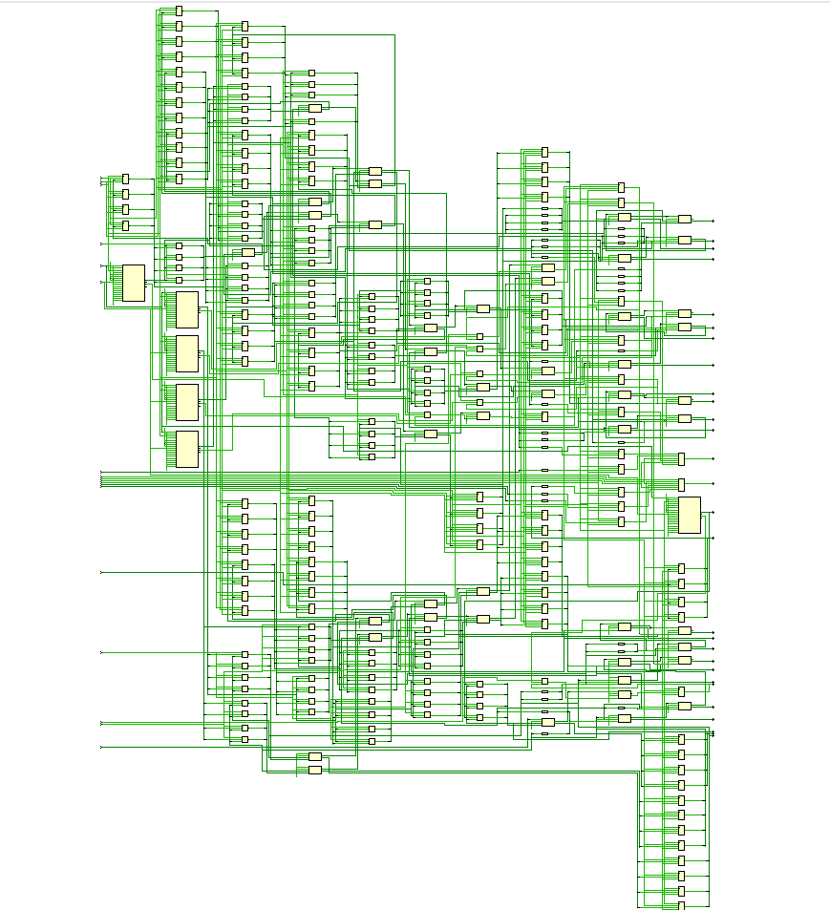
Hardware Schematic
Picture of Schematic from Vivado (post-synthesis)

Slide 15
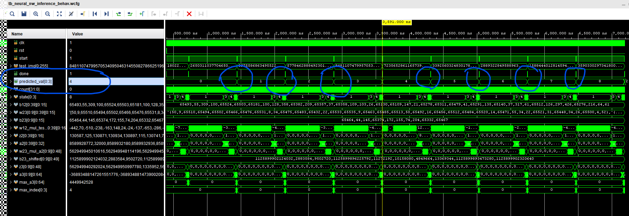
HW Simulation
Description of testbench –
Test Bench gives 10 sample images to the DUT in a loop.
Sample images are taken unshuffled from semeion.data. Indices [1, 21, 41, 61, 81, 101, 121, 141, 161, 181].
Input images are sent in a 256 bit array.
Once the DUT completes operation, DUT sends a DONE signal.
In Test Bench wait for DONE signal.
Upon Done, verify the predicted value from One-Hot encoded value of that input Test Data.
Vivado Simulation:

Slide 16
HW Simulation (Contd…)
Vivado Simulation:
Showing the signals & data at various stages

Slide 17
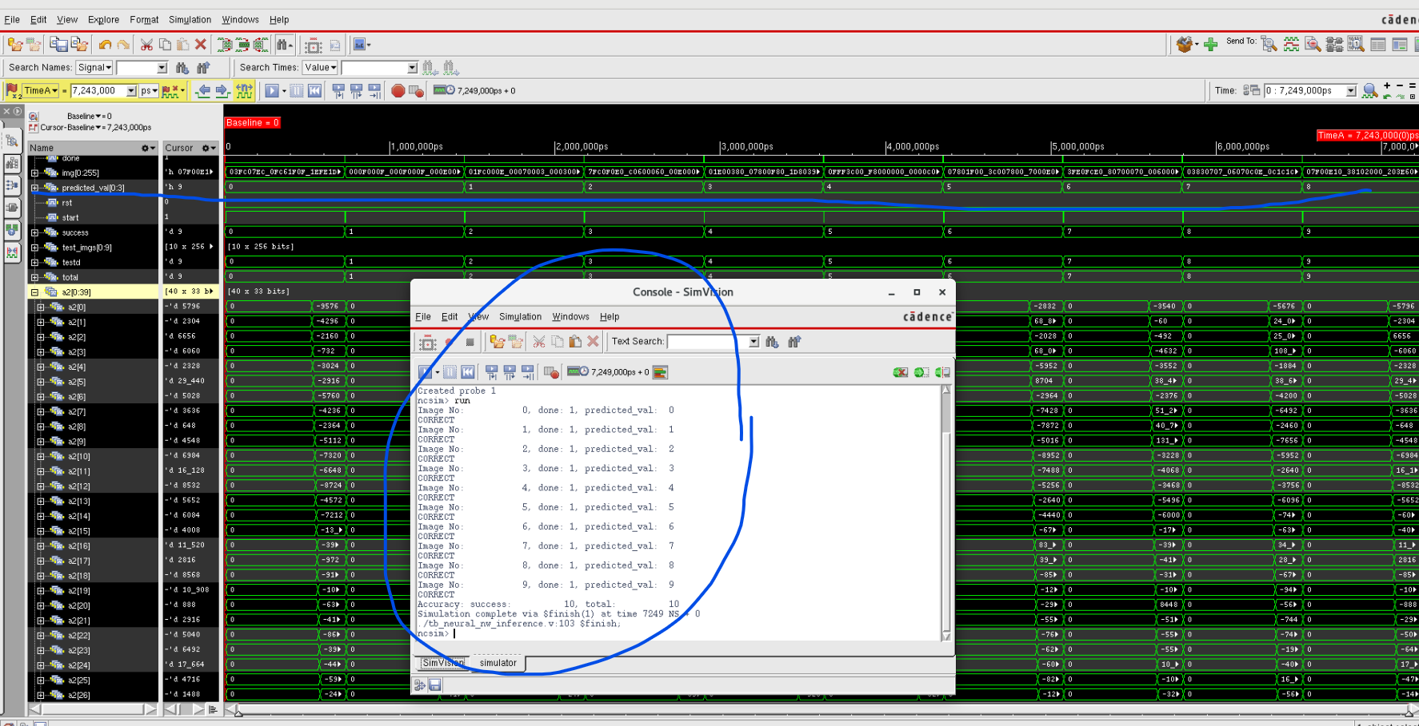
HW Simulation (Contd…)
Cadence NC Sim Simulation:
WorkSpace Path: /home/client25/Desktop/PVR/ML_Project/simulation/
Showing the signals & data at various stages

Slide 18
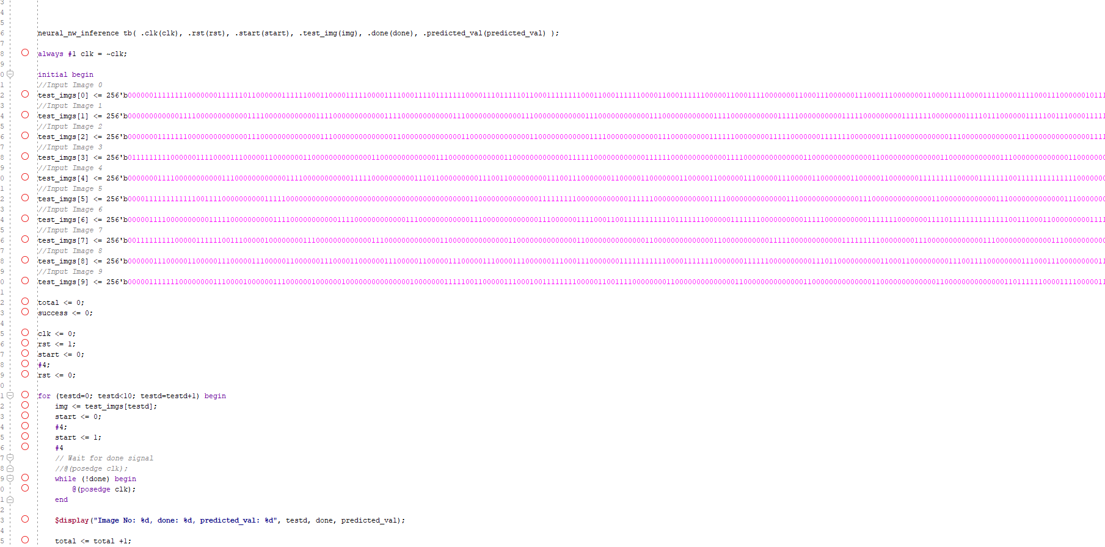
HW Simulation (Contd…)
Testbench:
“rst” signal is given at the beginning
“img” is set to the test image from the array “test_imgs[]” which points to 10 images
“start” signal is given
Testbench waits for “done” signal & then shows the predicted image.
Loop for 10 images from step #2 to #4 steps above.

Slide 19
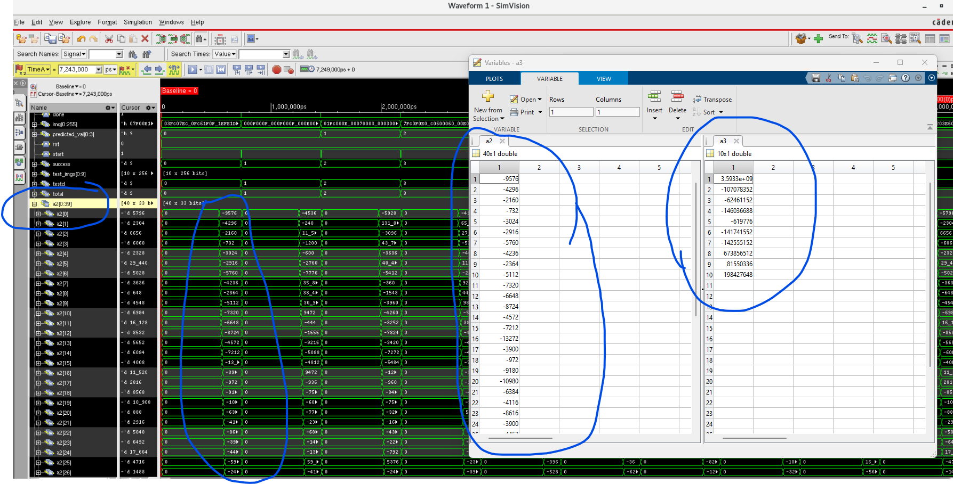
HW Simulation (Contd…)
Hidden Layer Output (NC SIM)
Hidden layer (a2) & Output layer (a3) shown below comparing Pre-Synthesis simulation & Matlab output
a2: Hidden layer output
a3: Output layer output

Slide 20
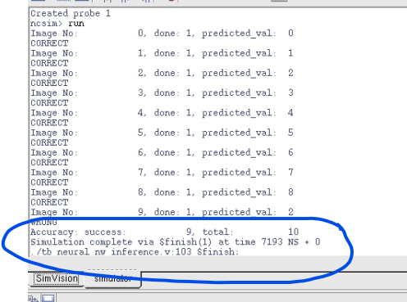
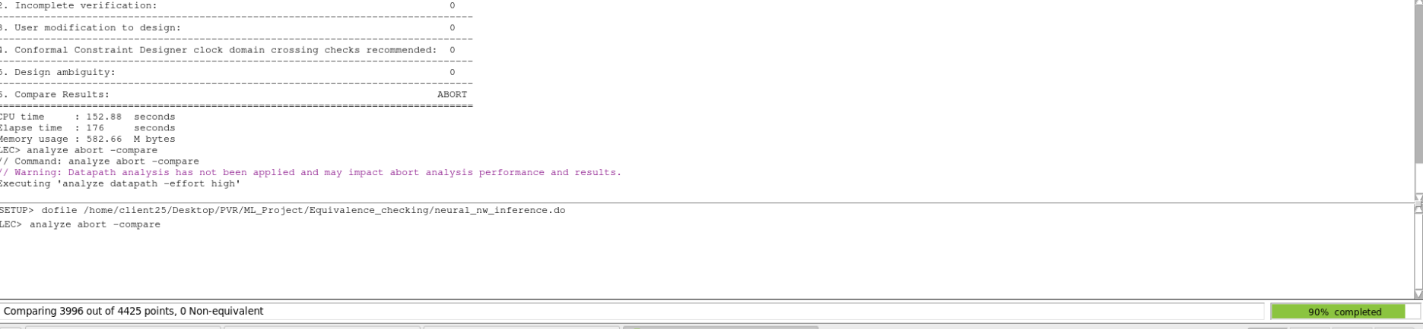
Accuracy Results
Software Accuracy:
Train data: 99.36365%
Testing with floating point weights: 90.872211
Test data with fixed point weights: 89.04665
Accuracy on HW:
Pre-synthesis: (10 images): 90%
LEC is stuck at 90%
If there is an accuracy drop, why has it happened?
Floating to Fixed point conversion causes the error. Increasing the bit width we can achieve more accuracy

Slide 21
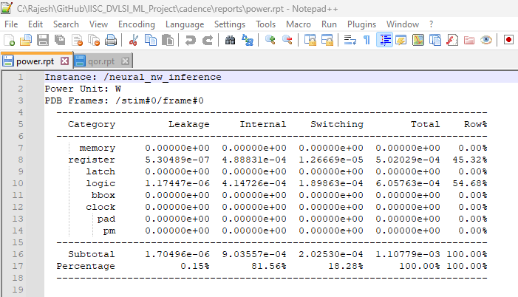
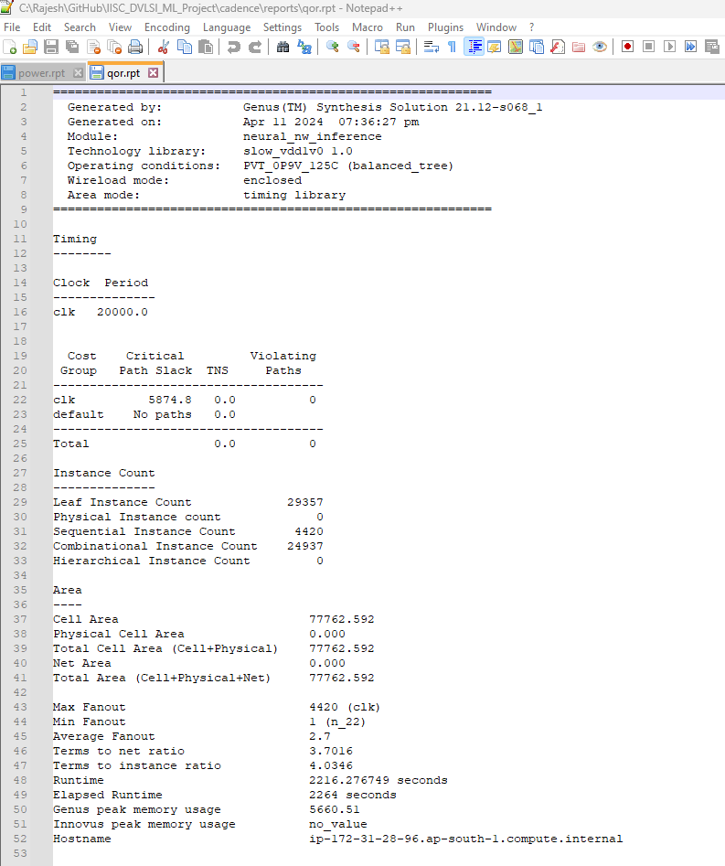
Synthesis Reports
QOR and Power Reports from Synthesis.
POWER
QOR

Slide 22
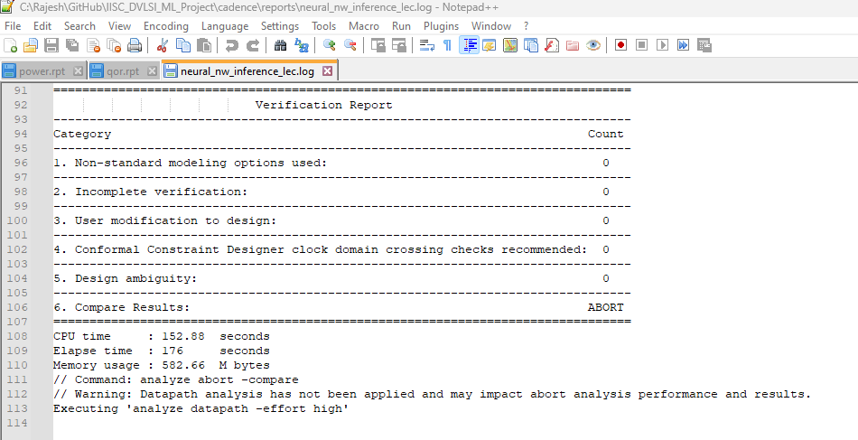
LEC Report
Picture of LEC report, and your conclusion from it.
Observed lot of Warnings post Synthesis. Need to change RTL to fix them when RTL code synthesized to Net List.

Slide 23
Placement
Picture of Placed Design
Got stuck at LEC.
WorkSpace: /home/client25/Desktop/PVR/ML_Project/

Slide 24
Routing
Picture of Routed Design
Got stuck at LEC.
WorkSpace: /home/client25/Desktop/PVR/ML_Project/

Slide 25
Post-Routing Reports
Setup and Hold Reports post-route
Power report
Geometry and Connectivity reports
Got stuck at LEC.
WorkSpace: /home/client25/Desktop/PVR/ML_Project/

Slide 26
Design Highlights
Describe key features/optimizations that you have done that can make your design stand out w.r.t. your peers.
Not found any.

Slide 27
GDS
Picture of successful GDS streamout from the terminal.
Got stuck at LEC.
WorkSpace: /home/client25/Desktop/PVR/ML_Project/

Slide 28
Conclusions
Number of neurons in hidden layer = 40
Accuracy on synthesized HW =
Clock Frequency = 20nSec
Latency = 737 Cycles
Initiation Interval =
Total Area =
Total Power (post-routing) =
Setup TNS and WNS (post-routing) = … and ….
Hold TNS and WNS (post-routing) = … and …
NOTE: Keep the format given here. Only fill the values

Slide 29
Learning Outcomes
What did you learn from this project?
First MATLAB usage to develop HW algorithms as Proof of concept & then implement them in Verilog for HW acceleration.
Cadence tools: Virtuoso for schematics, Genus for Synthesis, Innovus for Place & Route.
Machine Learning basics & processing of a large data in HW for acceleration.
Machine Learning on how to do inference part of a sample test data
Verilog coding differences between FPGA & ASIC for synthesizable code.
How to fix RTL when we get LEC/Synthesis errors.
How to code or change the code in Verilog that makes it Synthesizable & PASS LEC.
Programming differences between my Embedded Software C coding & Verilog coding differences.
Entire ASIC Flow from design to GDS.
Synthesis & LEC issues of the initial Verilog code and how to fix them to make them Synthesizable for ASIC.

Slide 30
Thank You

